Slide 1
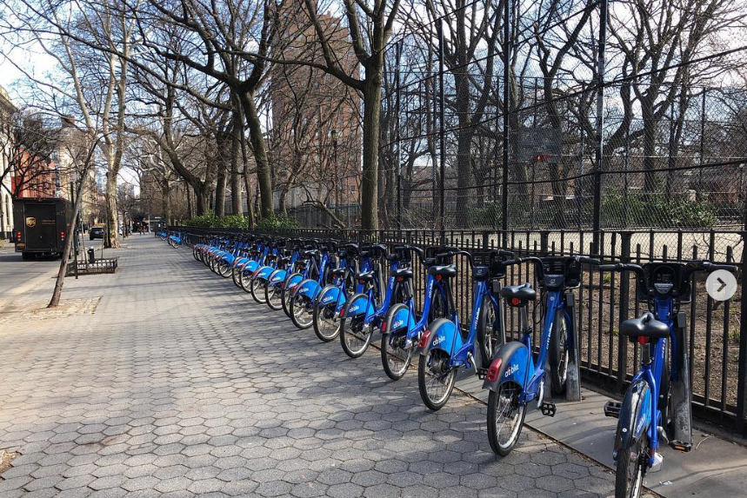
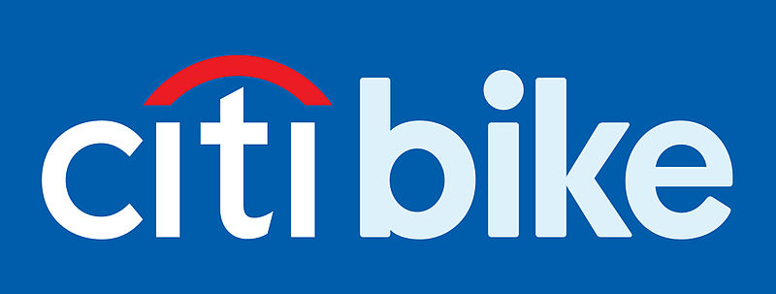
r
A look-back at New York City’s Bike Share Program, from 2013 - present
Olga Roginkin, Data Science Bootcamp, Rutgers, 04/2019

Slide 2
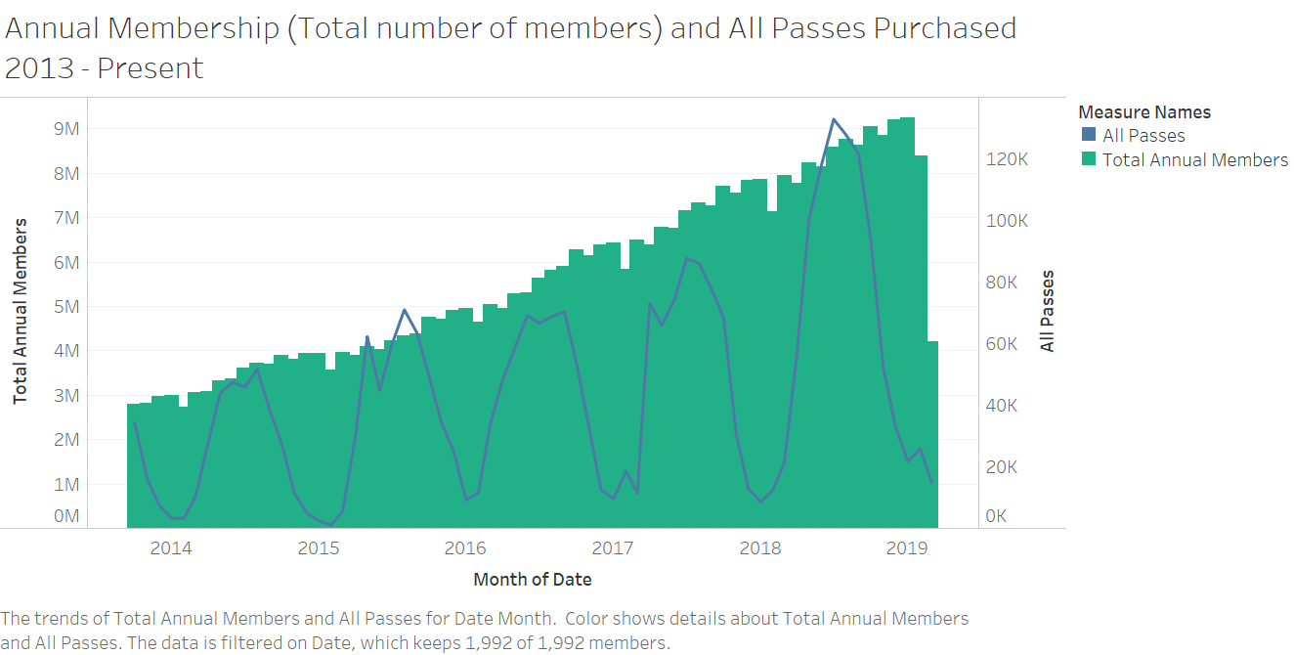
Annual Membership and The Number of Passes Purchased:
Total annual membership increased at a steady pace
Total number of passes purchased increases with 2018 being the year when the number of pass holders grew faster then in the previous years.
There were almost 9 million pass holders at the peak of the Summer season of 218.

Slide 3
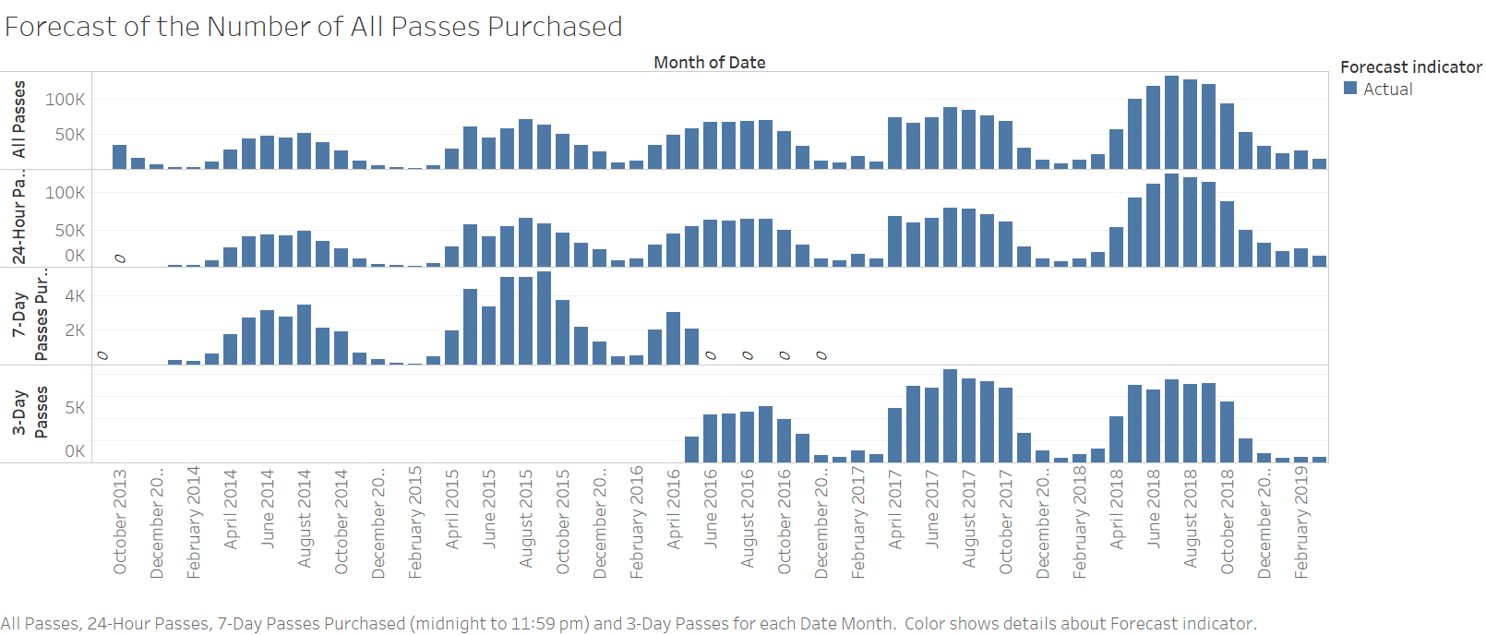
What Type of Membership is Popular (Look Back at the Preferences of the Riders):
Total number of passes increased over the years
24-hour passes are most popular
All types of passes are most popular in the supper months

Slide 4
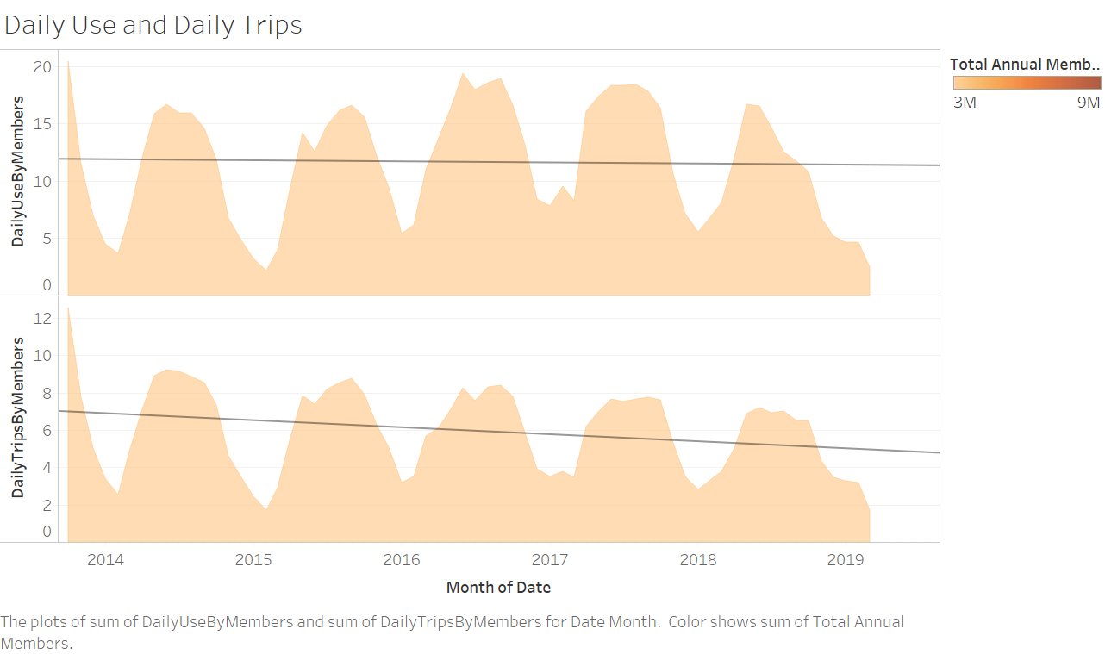
Do Members Ride More?
The length of daily trips made by the members did not change significantly between 2013 and present
The number of daily trips made by members (on average) decreased significantly

Slide 5
What Type of Pass is More Popular:
7-day pass was discontinued in Q2, 2015 and replaced by a 3-day pass
24-hour passes are most popular
7-day
3-day
24-hour

Slide 6
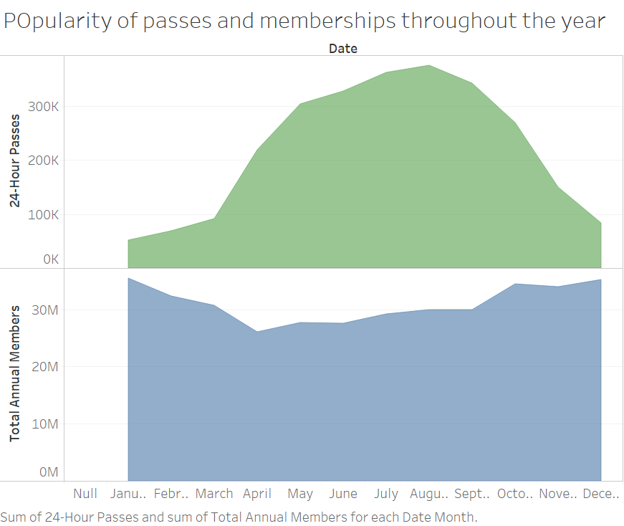
What Pass Should I Buy?
In the summer months, the number of 24-hour passes increases dramatically (6-fold) with August-September being the most popular months for this type of pass
The annual memberships increase around winter months and dip in the summer by about 25%

Slide 7
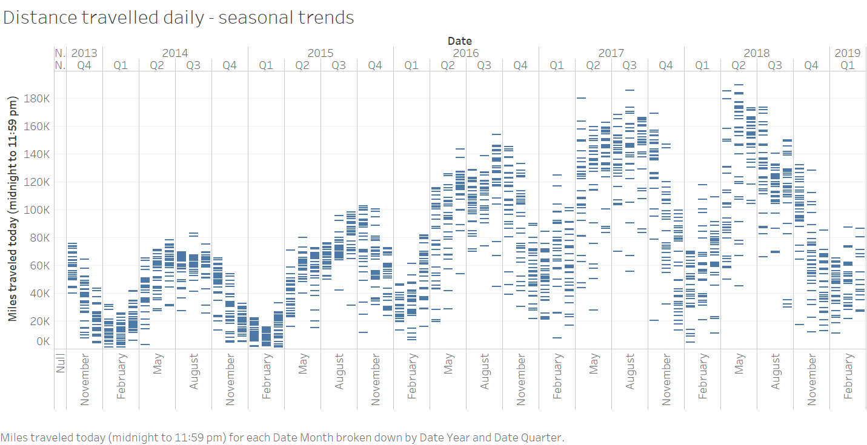
How Far Should I Ride?
The daily trips are getting longer overall
Summer is the season of the longest trips
Winter is the season of the shortest trips
Most longest trips occurred in 2018

Slide 8
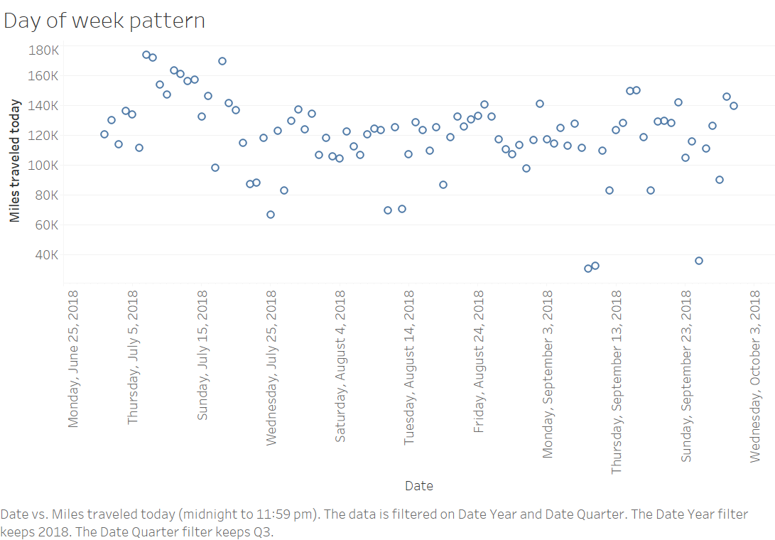
Which Day of the Week is the Most Popular Among the Riders?
There is no significant correlation between the day of the week and the miles traveled.
This is due to the fact that many tourists use Citi bikes therefore all days of the week seem to be equally popular
Weather and outside temperature might be more important factors than the day of the week in determining the total mileage travelled in a day

